Slide 1



ANTI-BULLYING WEEK 2024

Slide 2


ANTI-BULLYING WEEK 2024

Slide 3

Show Off Your Odd Socks!
What do they mean?

Slide 4
“
WHAT IS RESPECT?
Oxford Languages definition:
Have due regard for (someone’s feelings, wishes, or rights).
When you respect someone, you treat them kindly and use good manners.
“

Slide 5


https://youtu.be/sZ_CkltlgS4

Slide 6
“
WHAT IS BULLYING?
Our School definition
Bullying is unacceptable behaviour used by an individual or group, usually repeated over time, that intentionally hurts another individual or group either physically or emotionally.
“

Slide 7
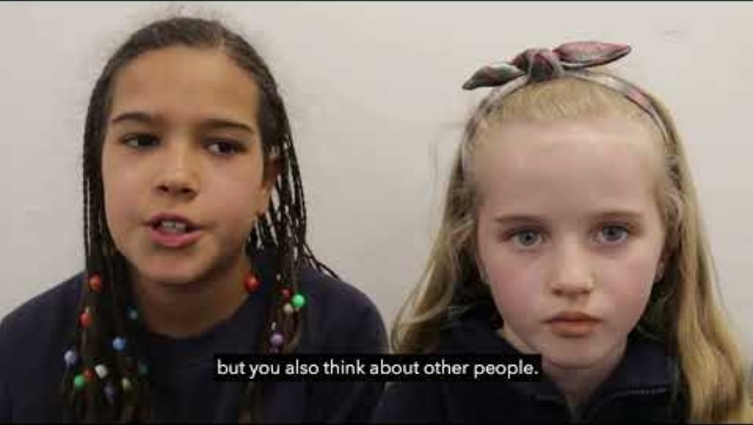
ANTI-BULLYING WEEK: PRIMARY SCHOOL VIDEO
https://youtu.be/UmI5hbQTIUw

Slide 8


ANTI-BULLYING WEEK: PRIMARY SCHOOL VIDEO
What was the message in the film?
How can we show respect to each other in school?
Should we be showing respect to everyone?

Slide 9
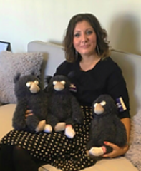

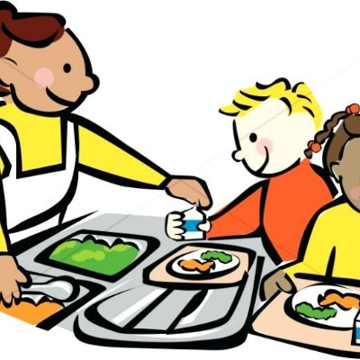
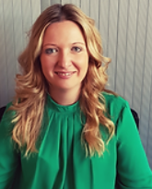
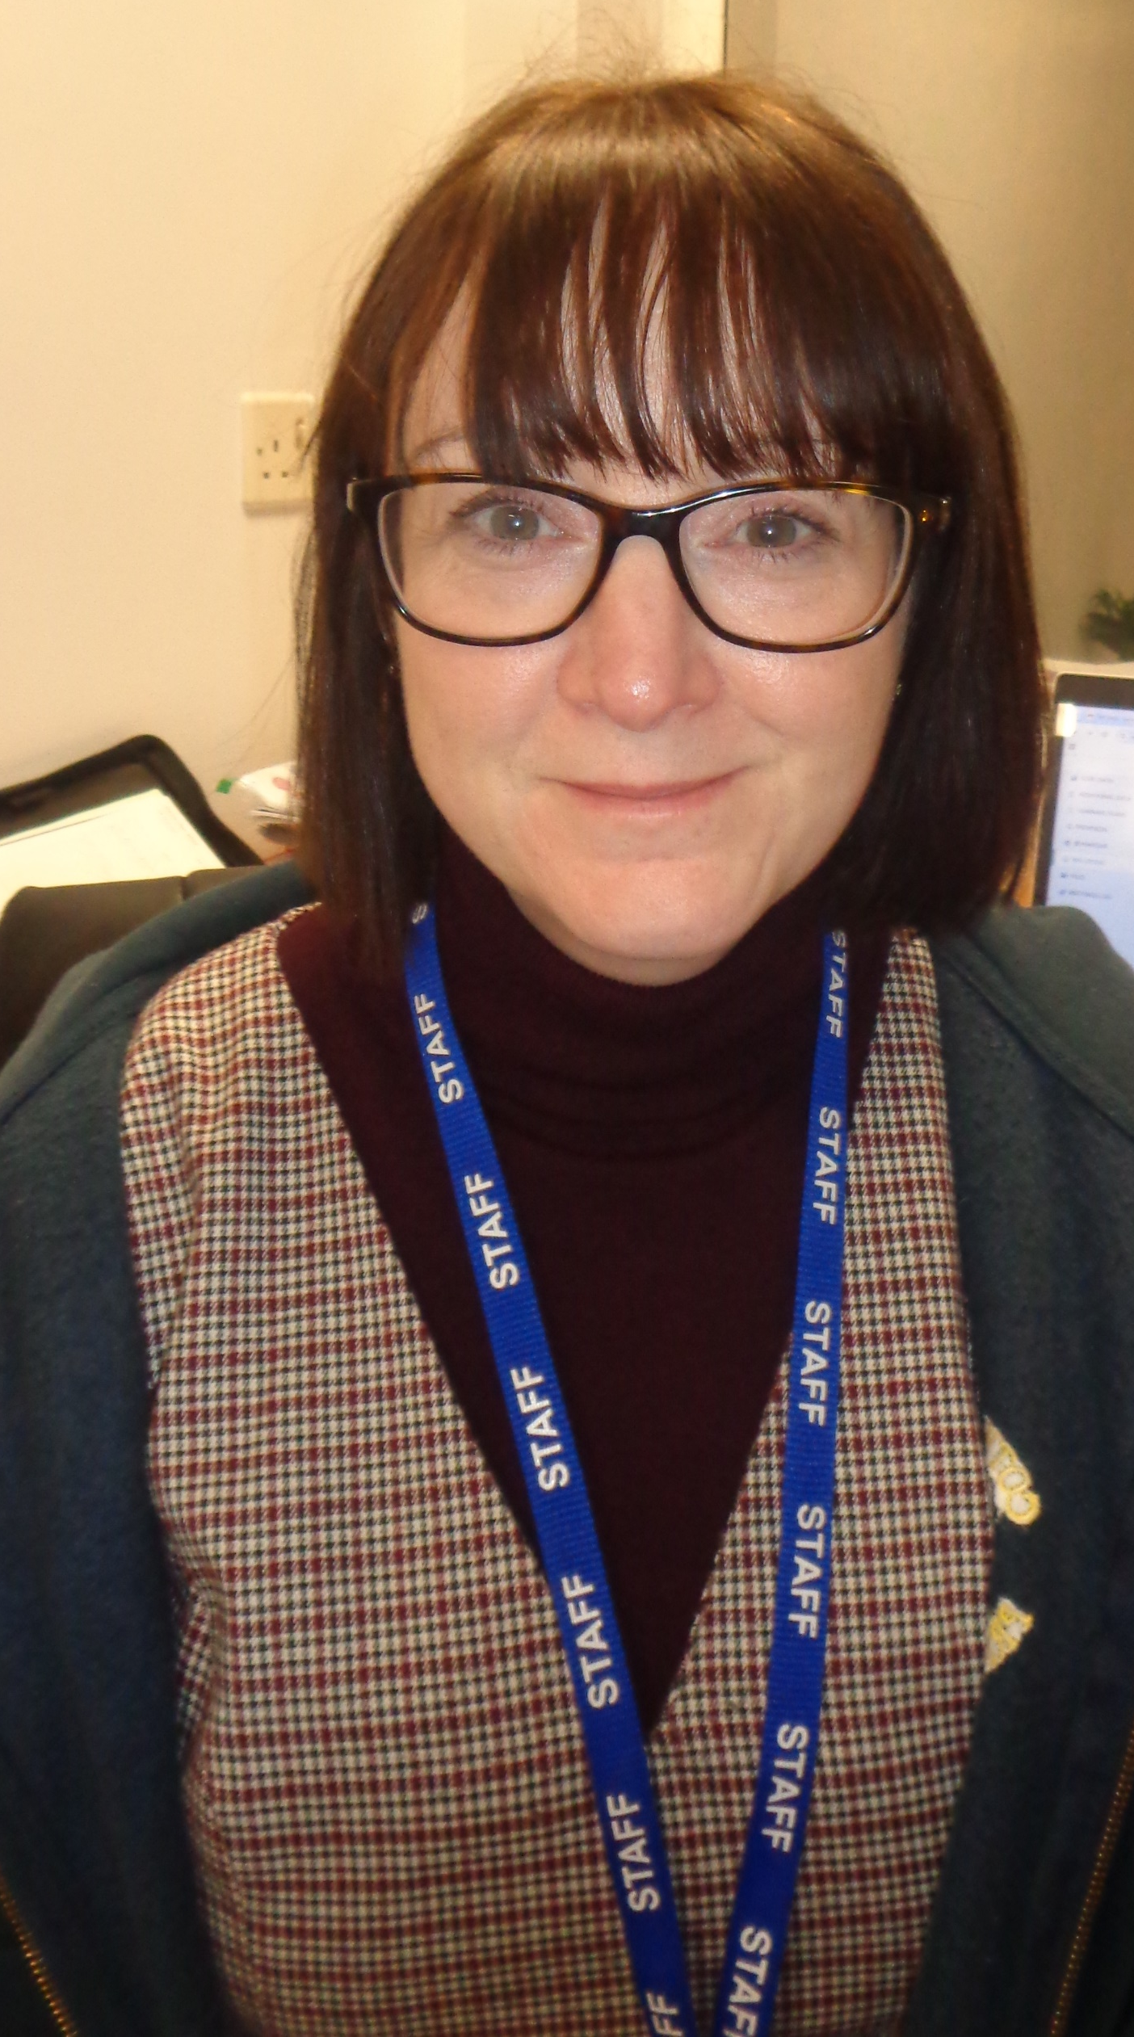
WHO CAN YOU SPEAK TO AT SCHOOL?
Mrs Williams,
Mrs Wilkes and
Mrs Mason
Lunchtime supervisors
Teachers

Slide 10
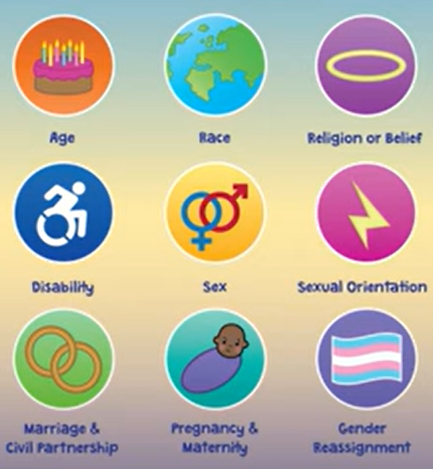
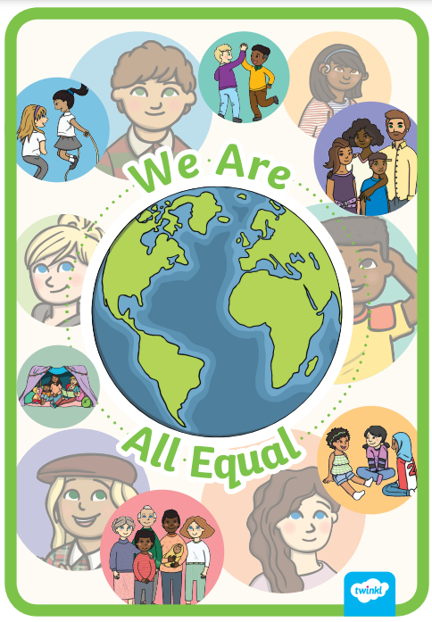
We are all equal
Poster competition
Please design a poster showing our protected characteristics and that we are all equal.
Hand your poster in to your class teacher by Friday 29th November.
The winners will have their posters displayed around school.

Slide 11



ANTI-BULLYING WEEK 2024
Monday 11th to
Friday 15th November
Odd Socks
Day 2024
Tuesday 12th November

