Slide 1
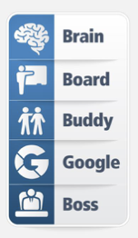
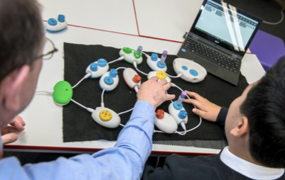
An Inclusive Computing Curriculum
Creating an Inclusive Environment
Space
The learning environment is important in making learners feel included. Incorporate representation of a diverse range of learners and professional figures in computing.
Arrange the learning space to promote collaboration and hands-on activities, whilst being mindful of how learners access their workstations.
There should be adequate space for learners to access assistive technology and software. There should be adequate space for learners to work off-screen, collaboratively and on paper.
Tasks
Incorporate learning materials that are accessible for learners of all abilities.
For learners with SEND, specific resources or approaches may be required to enable them to access the curriculum.
Ensure that you have considered what barriers learners may have within a less and embed support strategies to help them overcome these.
Scaffold learning so that all learners benefit from support during the initial phases of learning.
Planning Inclusive Lessons
Computing equips learners to use computational thinking and creativity to understand the digital world we live in. With the right combination of progressive, imaginative planning, exposure to a broad range of tools, technologies and support it it possible for all learners to fulfil their potential- in computing and throughout the curriculum.
Problem Solving
In computer science, there can be multiple solutions to a problem. Focus instruction and encouragement on solving problems and the problem-solving process , rather than finding a single correct answer.
Emphasize guided enquiry, designing learning opportunities where learners can ask questions, explore, try different approaches and challenge their own and other’s ideas.
Encourage learners to take ownership over their learning.
Visual Impairment
Interactive whiteboards are non-reflective to reduce glare.
Computer monitors are positioned to reduce glare.
Ensure that learners are taught how to adjust the screen resolutions on computers (brightness, contrast) and how to zoom in and out.
Coding is primarily taught using block-based programming languages such as Scratch.
Inclusive practices include allowing learning to orient themselves to the classroom space, careful selection of colours within resources, installing a screen reader and magnifying aids.

Slide 2
Computing Curriculum Considerations for SEND
How can I support learners who need additional time to develop conceptual understanding?
Break down content into small steps and allow time for guided practice to build up conceptual understanding.
Assess and use learner’s prior knowledge to create link between old and new content.
Address misconceptions early.
Arrange for another learner to be a ‘computing buddy’ to provide consistent help and support during lessons.
Provide opportunities for learners to work in a group rather than independently
How can I support learners who struggle to access lessons due to literacy difficulties?
Provide printouts of the instructions that will be used in the lesson.
Where necessary, provide screenshots of the programme that will be used in the lesson.
When using the interactive whiteboard, avoid black text on a white background.
Demonstrate how to enlarge or zoom in on a page when using a computer so that the text and images can be clearly read and understood.
Reduce glare with the use of pastel shades of paper and computer backgrounds.
Strategies to Scaffold Learning
How can I support learners who struggle with attention?
Carefully consider the layout of the learning environment to engage all learners, maximise access to resources and limit potential distractions.
Learn what hobbies or topics the learners are interested in. Find ways to incorporate this into lessons and questions.
Give clear instructions within the form of a checklist.
Reinforce instructions on how to use computing equipment.
Be explicit about the rules of when to use the equipment.
Help learners to manage their arousal levels. Arrange movement breaks away from the learning environment when they require a ‘break’ away from the lesson.
How can I support learners who struggle to retain vocabulary?
Pre-teach any technical vocabulary prior to the lesson.
Embed opportunities to recall key terms within lessons using retrieval practices.
Provide learners with a word bank of key terms which they can refer to during lessons.
Use rephrasing techniques to strengthen learner’s answers with the correct vocabulary.
Introduce new terms slowly and rehearse new words.
How can I support learners who have sensory issues?
Choose resources and tasks that support alternative ways of communicating.
Ensure a low arousal area is available for those learners who may need it.
Ear defenders can enable learners to partake in lessons with more confidence.
Some learners may become deeply engaged in tasks. Clear preparation and support will assist with ending a task.

