Slide 2
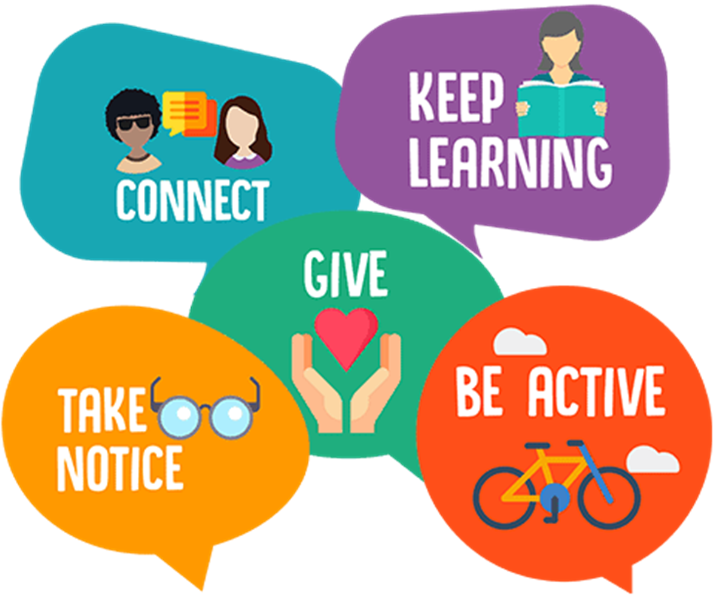
5 Ways to Well-being

Slide 3
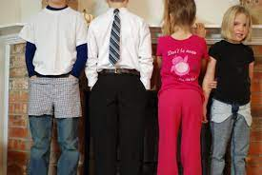
Why are we all wearing our clothes inside out today?
How are you feeling today? Can you identify different emotions

Slide 4
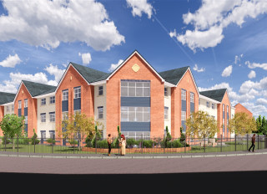
How are we celebrating Children’s Mental Health Week at Cotwall End?
Inside Out Day!
Art afternoon – art competition
Bracelets- £1 – profits to Young Minds
Citizenship Assembly

Slide 5
Together by Matt Goodfellow
Watch this video: https://youtu.be/bOsbofgusak.
Poet Matt Goodfellow reads his poem 'Together' as part of Children's Mental Health Week 2023. This poem is taken from the book 'The Same Inside', published by Macmillan.

