Slide 1
An Inclusive Geography Curriculum
Planning Inclusive Lessons
To make geography lessons inclusive, teachers need to anticipate what barriers to taking part and learning activities, lessons or a series of lessons may pose for learners.
At times, it may be appropriate to plan smaller steps with step-by-step instructions to achieve the learning outcome or provide additional resources.
Exploring opportunities for group and partner work within fieldwork can support learners to remain on task and provide peer support.
Multi-sensory Approaches
Build on learners preferred learning styles when explaining concepts, by using different media, e.g. diagrams, stories, acting out processes, concept mapping etc.
Use mind maps to help learners see patterns and relationships.
Simple audio recorders can be used instead of written notes during investigations or visits.
Health and Safety
Remember that some learners may have a low awareness of danger.
Identify risk points in the lesson, visit or field trip e.g. for learners with noise or smell sensitivity.
Low-arousal Areas
Geography lessons and fieldwork can be overwhelming for some learners due to the changing nature of the lessons- allow learners time and space if overwhelmed.
A low-arousal area (quiet area with calming, sensory resources) is available for planned and unplanned sensory breaks.
Allow time-out within the area of learning (if not in the classroom e.g. fieldwork) where the learner can calm down if needed- agree this space with the learner.
Creating an Inclusive Environment
Seating
Learner's seating and the main position are planned for the shape of the room.
Seating positions should allow all learners to communicate, respond and interact with each other and the teacher in discussions.
Furniture is suitable and learners have the equipment they require e.g. sloping board, foot block.
Sound and Light Issues
Background noise is reduced.
Interactive whiteboards are non-reflective to reduce glare.
There is sufficient light for written work
Learners use hearing and low vision aids where necessary.
The teacher’s face can be seen- avoid standing in front of light sources.
Video presentations have subtitles for deaf, hearing impaired and those with communication difficulties.
Unfamiliar learning environment
During fieldwork, give clear rules to follow for safety. Accepts that being outside is exciting but remain firm that learning is the focus.
Ensure that there are adequate breaks so that learners with physical needs do not become tired.
Resources
Ensure that maps, atlases, artefacts, models and photographs are accessible and labelled clearly.
Makes use of learners own digital presentations e.g. of a visit or field trip.

Slide 2
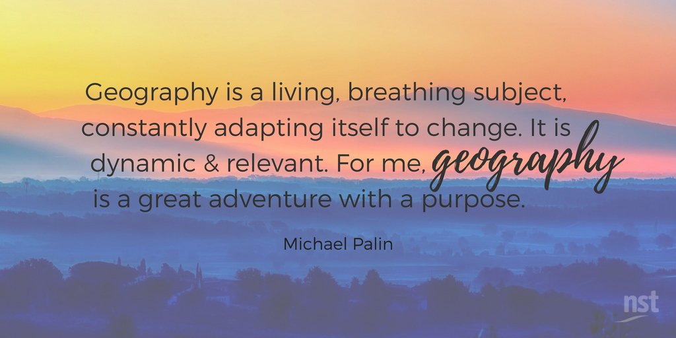
Geography Curriculum Considerations for SEND
How can I support learners who struggle to access lessons due to literacy difficulties?
Dyslexia friendly approaches including the use of pastel colour paper, font size and type.
Reading text-heavy atlas pages or summarising withing handouts if required.
Record learning in different ways e.g. visual, written, drawing, graphs etc.
How can I support learners who experience anxiety?
Geography lessons and fieldwork can be overwhelming due to the changing nature of the lessons- allow learners time and space if overwhelmed.
Prepare the learner before the geography lesson, visit or fieldtrip beforehand.
Provide reassurance as difficult concepts are explicitly taught, e.g. lines of latitude, longitude etc in different wats (atlas, map, globe).
Provide short learning breaks if required.
Strategies to Scaffold Learning
How can I support learners who struggle to retain vocabulary?
Pre-teach any geographical vocabulary prior to the lesson.
Embed opportunities to recall key terms within lessons using retrieval practices.
Provide learners with a word bank of key terms which they can refer to during lessons.
Refer to language regularly during lessons and, where applicable, throughout the day, as this will embed the vocabulary and build stronger links and associations.
How can I support learners who need additional time to develop conceptual understanding?
Provide pre-teaching opportunities for learners to become familiar with vocabulary prior to the lesson, to support their access and engagement in whole-class teaching.
Plan small group teaching and fieldwork opportunities.
Some learners have definite ideas based on their prior knowledge which may need to ‘untaught’.
How can I support learners who struggle to access lessons due to numeracy difficulties?
Access to physical resources with their use properly demonstrated.
Lots of practice looking from whole-word maps to sections-use physical props to help e.g. ‘picture frame’- draw a frame around an area and allow the learners to explore the shapes of the land and sea to help build links.
Support with quantitative data e.g. graphs, charts etc.
How can I support learners who struggle with attention?
Due to its hands-on nature, Geography is a subject where learners can excel.
Ensure all resources are available for learners to explore prior to the lesson and, if support is required to allow access to materials, e.g. atlases.
Plan movement breaks and classroom jobs for individual learners.
How can I support learners who have sensory issues?
Choose resources and tasks that support alternative ways of communicating.
Ensure a low arousal area is available for those learners who may need it.
Ear defenders can enable learners to partake in lessons or fieldwork with more confidence.

