Slide 1
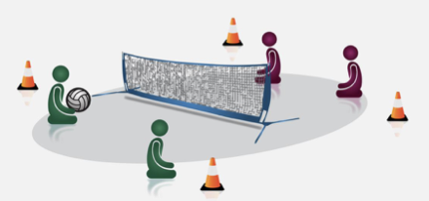
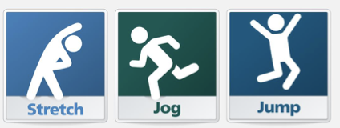
An Inclusive PE Curriculum
Communication
Use the learner’s preferred communication method- vernal, Makaton, symbols or a combination to ensure that all lessons and activities are accessible.
Use key words, signs, symbols and simple language when delivering instructions to support learners with poor receptive language and processing delays.
Clear and precise names for strategies and techniques can support learners to acquire the knowledge they need to participate in the activity, e.g. clear names for rules.
Task
Changes and adaptations can be made to activities and specific tasks to ensure all learners are able to participate fully.
Planning Inclusive Lessons
An inclusive PE curriculum should both engage and inspire young people to lead healthy and active lifestyles and broaden their experience of sport and fitness activities.
PE and sporting activities should be accessible regardless of a learner’s disability or needs.
A valuable tool to support the planning and delivery of accessible, inclusive and aspirational PE lessons for all learners is the C-STEP Principle.
C-STEP prompts consideration of how we communicate, use space and adapt the task, equipment and support learners to ensure they participate and thrive in PE lessons regardless of their physical and learning needs.
Equipment
By making modifications to, and sometimes changing the equipment used, can ensure that all learners are able to participate, enjoy and experience success in PE lessons.
Adaptations include:
Using balloons with rice in or a ball with a bell to support visually impaired learners.
Large, bright, shiny, tactile resources to engage more sensory learners, e.g. a ball wrapped in foil/ bubble wrap.
Making adaptations to the size, weight and grip of PE equipment .
Using assistive resources to support learners in target sports, e.g. ramps to play boccia and cricket.
Space
Carefully consider the environment to ensure all learners can access PE lessons and sporting activities. By making adaptations to the physical environment and space, all PE lessons will be inclusive for wheelchair users and learners with a range of physical needs.

Slide 2
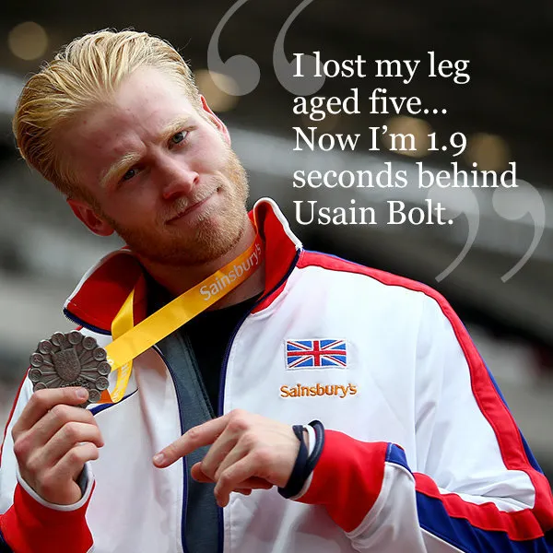
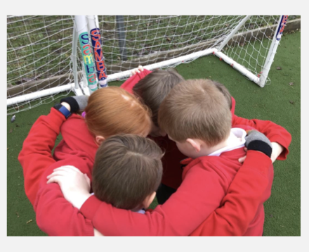
PE Curriculum Considerations for SEND
Multi-Sensory Approaches
Orienteering trails and physical activities may need to incorporate the use of sound, touch or different colours to support some learners with navigation.
Visual timetables, visual prompts can aid organisation and shared signals can support learners to convey their understanding, uncertainty or need for help.
People
The support learners receive from key people throughout a PE lesson can significantly impact their skills, attitudes and progress.
An adult can model skills, break down activities into smaller steps and support the over-learning of skills.
Peers can supportively help to motivate and model skills whilst ensuring a learner maintains their independence and doesn’t become over-reliant on the support of an adult.
Learners working in mixed-ability groups can provide aspirational role models and opportunities for the most able to develop their skills through demonstrating and coaching.
As the learner’s competence and confidence develops, the support provided can be slowly reduced to enable the learner to participate more independently.
Unfamiliar Learning Environments
Ensure that learners are well-prepared for visits to sporting events, swimming lessons and residential centres. This can include the use of social stories, photographs, videos and objects.
Alternative routes may be required for orienteering for learners with physical difficulties.
Visit leaders will be required to liaise with Specialist Outdoor Centres to ensure that they are prepared and have the equipment and resources to enable learners with additional needs to participate fully.
Individual Pupil Risk Assessments are required for those learners who will require additional consideration, adjustments and support.

